Slide 1
Hypothesis Testing

Slide 2
• Remember significant meant a result didn’t happen by chance. • One of the most common questions in statistics is whether or not results are significant.

Slide 3
• To see if a result is significant, we perform a hypothesis test. • The name comes from the fact that one of two hypotheses is true … basically it IS significant or it ISN’T.

Slide 4
• We will say a result is significant if there is a very low probability it just happened by chance. • Just how low depends on the nature of the problem.

Slide 5
FIRST, let’s look at HYPOTHESES • H₁ = Alternative hypothesis … says a result IS significant • To find H₁, copy the question, but turn it into a statement.

Slide 6
• H₀ = Null hypothesis … says a result ISN’T significant • To find H₀, just put “NOT” into H₁.

Slide 7
Example: A poll was taken asking people whether they liked what the President was doing and what Congress was doing. Was the President’s approval rating significantly higher than Congress’ approval rating?

Slide 8
• H₁ = The President’s approval rating was significantly higher than Congress’ approval rating. • H₀ = The President’s approval rating was not significantly higher than Congress’ approval rating.

Slide 9
Example: ILCC reports that its average class size is 16. A sample of classes at the Algona center is taken. Do classes at the Algona center average significantly less than 16 students?

Slide 10
• H₁ = Algona classes average less than 16 students. • H₀ = Algona classes don’t average less than 16 students.

Slide 11
Your book would phrase this as μ > 16 and μ < 16.

Slide 12
H₁ and H₀ are always opposites of each other. • One or the other must be true.

Slide 13
• Technically a successful hypothesis test shows that the null hypothesis can’t be true … so the only possible option is the alternative hypothesis (a significant result).

Slide 14
LEVEL OF SIGNIFICANCE • Variable: α (alpha) • How often we’re willing to accept that a result we say is significant actually just happened by chance.

Slide 15
• Literally α is the probability you say a result was significant, but it really just happened by chance. • It’s the probability we’re wrong when we say a result is significant.

Slide 16
• We typically want this number to be as low as possible. • Most common levels are 10% (.01), 5% (.05), and 1% (.01) • The more important the research, the lower the level of significance

Slide 17
What happens when we do a hypothesis test? • We will compare our result with all the possible results of every possible sample (the sampling distribution).

Slide 18
The result will be significant if it is big enough that it is out in the tail of the normal curve, beyond almost all of the results that might have happened by chance due to sampling error.

Slide 19
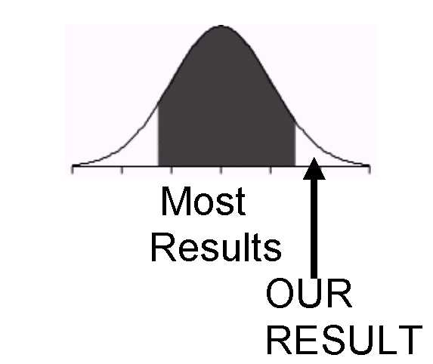

Slide 20
Steps for a Hypothesis Test: There are several possible ways to do a hypothesis test. We will primarily focus on what is called the classical hypothesis testing method.

Slide 21
Steps for a Hypothesis Test: There are several possible ways to do a hypothesis test. We will primarily focus on what is called the classical hypothesis testing method.

Slide 22
The basic idea is that we will find a cut-off line (using a table) and see which side of the cut-off line (significant or not significant) our results are on.

Slide 23
BEFORE THE TEST: In book and test problems, these steps are often already done for you. You can also often do them in your head, but not actually write anything down.

Slide 24
Define the problem. p Carefully read through things or gather data. p Make sure you understand the question that is asked.

Slide 25
p Calculate all necessary variables for the problem. p Determine the appropriate test.

Slide 26
2. Find the hypotheses. H₁: ALTERNATIVE HYPOTHESIS = significant difference H₀: NULL HYPOTHESIS = result is not significant

Slide 27
3. Determine level of significance (α). p In book or test problems this will always be given. p In real life, you need to decide based on how important the problem is.

Slide 28
DURING THE TEST: (main steps you ALWAYS have to do)

Slide 29
4. Find the critical value. p Look up a value of “z”, “t”, or another statistic in the appropriate table. p This is essentially a cut-off value that determines whether something is significant or not.

Slide 30
5. Calculate a test statistic. p Use a graphing calculator (or a formula) and your data. p This is the actual value of a statistic (such as “z” or “t”) that corresponds to your data.

Slide 31
AFTER THE TEST: (Interpret your result; decide if it’s significant.)

Slide 32
6. Compare the test statistic with the critical value. p You need to determine which value is greater.

Slide 33
• (In most cases) p Test > Critical ➔ SIGNIFICANT p Test < Critical ➔ NOT SIGNIFICANT

Slide 34
• Put another way … p Calculator > Table ➔ SIGNIFICANT p Calculator < Table ➔ NOT SIGNIFICANT

Slide 35
When you compare results, you ignore any negatives (technically you compare the absolute values), because both tails of the normal curve are equivalent.

Slide 36
QUICK SUMMARY: 1. Define (find variables) 2. Hypotheses (H₁ and H₀) 3. Significance (α) 4. Critical value (table) 5. Test statistic (calculator) 6. Compare

Slide 37
A side note … The tests we will do in this class are what are called one-tail tests because we will ask whether a result is significantly higher or whether it is significantly lower than it should be.

Slide 38
It is also possible to do two-tail tests, where the question is whether a result is “different” than it should be (but you don’t know whether it’s higher or lower).

Slide 39
While your book makes a big deal of two-tail tests, in the real world you pretty much always have an idea ahead of time which way (higher or lower) your results seem to be, so one-tail tests make more sense.

Slide 40
EXAMPLE: As a quick example, let’s look at a 1-proportion z-test:

Slide 41
According to the U.S. Census says just 34% of American households have children under the age of 18. A survey of 55 households in the Spencer area found that 22 of them had children under 18.

Slide 42
Do a 1-proportion t-test at the Is the percentage of households with children in Spencer is higher than it is nationwide? Do a 1-proportion z-test at the 5% level of significance.

Slide 43
1. Define (find variables) In reading the problem we find: • Nationwide the percentage is 34% • In Spencer it is 22 out of 55

Slide 44
2. Hypotheses (H₁ and H₀) • H₁: The percentage of households with children in Spencer is higher than it is nationwide. • H₁: The percentage of households with children in Spencer is not higher than it is nationwide.

Slide 45
3. Significance (α) • The problem says 5%

Slide 46
4. Critical value (table) • We’ll learn how to do this later, but it turns out that the table value we’ll compare to is z = 1.645

Slide 47
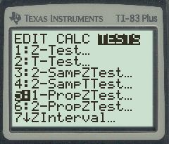
5. Test statistic (calculator) • On a graphing calculator, go to STAT → TESTS → 1-PropZTest (Choice 5)

Slide 48
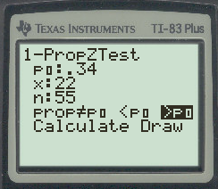
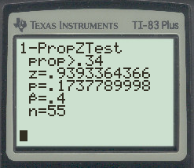
For classical hypothesis tests, it doesn’t really matter what’s highlighted on the ≠, <, > line.

Slide 49
What matters in the result is that z = .939

Slide 50
5. Compare • Since .94 < 1.645, this is NOT a significant result. • Spencer probably has about the same percentage of households with kids as the nation as there are nationwide.

Slide 51
Note that the result doesn’t mean the percentage in Spencer is LESS. It could be less, but it’s probably but rather that it’s ABOUT THE SAME as it is nationwide.

Slide 52
This basic process is used for all types of hypothesis tests. We will start by learning various types of z-tests and t-tests.

Slide 53
(1-sample) Z-Test • Use this test when you either know the standard deviation of the population (from long-term or census data) or you have a big sample (remember 30 or more is big).

Slide 54
Critical Value (Table Number) • You can find this several ways. • The easiest is to use the table called “Student’s t Distribution” in the back of your book or the end of the insert.

Slide 55
• Go to the infinity row at the bottom. • Find the level of significance for a “one-tail” test at the top.

Slide 56
• Read off the answer. p Most often 1.282, 1.645, and 2.326

Slide 57
Test Statistic (Calculated Value)

Slide 58
Without a TI-83 Use the formula

Slide 59
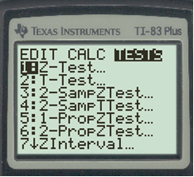
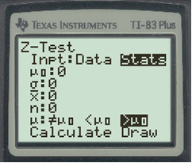
On a TI-83: • STAT … TESTS … Z-Test (first choice) Just as we did for intervals, you want STATS to be highlighted.

Slide 60
The variables mean: • μ₀ … expected mean or mean of population • σ … standard deviation (of population or big sample) • X-bar … actual mean of sample • n … number in sample

Slide 61
• On the next to last line, it doesn’t matter what you highlight p Technically it’s asking whether your actual mean appears to be less or more than the actual mean.

Slide 62
p However, nothing we will use in the answer depends on this setting for a classical hypothesis test.

Slide 63
• On the last line, highlight Calculate, and hit ENTER. • The read-out will give the calculated value for “z”, which is what we need.

Slide 64
Typical Problem: A teacher thinks her class is really dumb. She gives all 25 of her students an IQ tests, and she finds the class average is 89.

Slide 65
She knows average IQ is supposed to be 100, with a SD of 15. Is the class significantly below average?

Slide 66
We know . . . X-bar = 89 μ = 100 σ = 15 n = 25

Slide 67
HYPOTHESES H₁ = The class is significantly dumber than average. H₀ = The class is not significantly dumber than average, (Any difference from normal could just be due to chance.)

Slide 68
LEVEL OF SIGNIFICANCE Since it’s not given, for our level of significance, we will choose α = .10, which is a fairly standard level for education and social science. (.05 and .01 are also common levels of significance.)

Slide 69
CRITICAL VALUE To find the critical value, we will look up the number that goes with .100 significance in the row of the t-table. z = 1.282

Slide 70
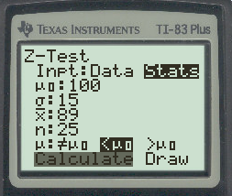
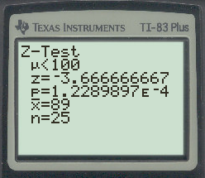
TEST STATISTIC

Slide 71
COMPARISON • We ignore the negative when making our comparison. • Compare 1.282 with 3.667 • Obviously 3.667 is larger.

Slide 72
• Since the calculated value (test statistic) is bigger than the critical (table) value, this IS a significant result. • So . . . the teacher’s class really is dumber than average.

Slide 73
“Z” is the normal distribution. When we use it we technically need to know one of these things:

Slide 74
The standard deviation of the population (σ) is known • The sample is large and comes from a normally distributed population

Slide 75
Unfortunately, we rarely know the standard deviation of the population and we often need to get by with small samples. The most common test to use with small samples is called a t-test.

Slide 76
• This is the “Student’s t distribution” that we have already used to find “z”. • In general, you should use “t” in with samples where n < 30.

Slide 77
(1-Sample) T-Test • Everything here works the same as the one-sample z-test, but it used for smaller samples.

Slide 78
Again, 30 is typically the cut-off between small and large samples.

Slide 79
On a TI-83, use Choice #2 (T-Test) in the “TESTS” menu. • Everything works just like a z-test.

Slide 80
Example: An insurance company claims that the average value of a home in Happyville is $135,000. A homeowners’ group looks at 16 homes in Happyville and finds that the average value is $122,500

Slide 81
and the standard deviation is $5,875. Is the average cost of homes in Happyville significantly less than the insurance company claims? (Use α = .05)

Slide 82
Hypotheses: H₁: The average cost is significantly less than $135,000. H₀: The average cost is not significantly less than $135,000.

Slide 83
Level of Significance: The problem says to use α = .05

Slide 84
Critical Value: • Use the one-tail row at the top of the “Student’s t- distribution” to locate .050 • For a one-sample t-test, d.f. = n - 1

Slide 85
Since there are 16 homes in the sample, we have 15 degrees of freedom. • t(.05,15) = 1.753

Slide 86
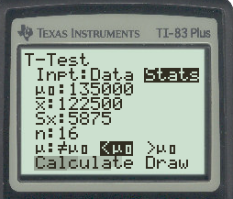
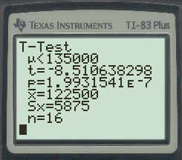
TEST STATISTIC t = -8.5106

Slide 87
Comparison: • Use absolute value of -8.5106 … that is 8.5106 • This is greater than the critical value of 1.753. • SIGNIFICANT

Slide 88
NOTE: It’s fairly common to get quite big answers with “t”, but more unusual with “z”.

Slide 89
Two-Sample t-test • Compares the mean of 2 different samples. • Is one group significantly higher than the other?

Slide 90
Critical Value • Use t-table • For the degrees of freedom in the critical value, use df = n₁ + n₂ – 2 • Your calculator will also give you the degrees of freedom.

Slide 91
TEST STATISTIC Without a graphing calculator, you would use the formula:

Slide 92
On a TI-83, select choice #4 (2-SampTTest) from the TESTS menu.

Slide 93
_ x₁, s₁ and n₁ are the mean, standard deviation, and number in the first sample. _ x₂, s₂, and n₂ are the mean, standard deviation, and number in the second sample.

Slide 94
• On the next-to-last line, the calculator asks whether the information is pooled. • To have your calculator find the degrees of freedom, answer YES to this question.

Slide 95
Example: The Greater Chicagoland Convention and Visitors Bureau did a survey to find the average income of people who visited the city for various reasons.

Slide 96
A sample of 27 people who attended sports events found the average family income was $87,900 with a standard deviation of $12,970, and a sample of 19 people who attended the theatre found the average family income was $127,400, with a standard deviation of $28,950.

Slide 97
Do these results indicate that people who attend sports events earn significantly less than those who go to the theatre? Use the .01 level of significance.

Slide 98
Critical: df = 27 + 19 – 2 = 44 (… or wait and have your calculator find it)

Slide 99
We’ll use the closest number in the table to 44, which is 45. t(45, .01) = 2.412

Slide 100
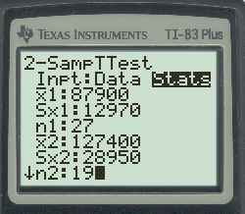
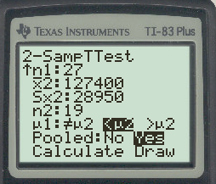
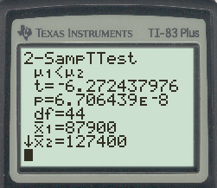
Test: t = -6.272 df = 44

Slide 101
COMPARISON: Since 6.272 > 2.412, yes this is a significant result.

Slide 102
NOTE: Theoretically you can do 2-sample z-tests as well as 2-sample t-tests. • The process is identical, but you would find your critical value just as for any z-test.

Slide 103
• If either sample is small (which will mostly be the case for us), you will use a t-test.

Slide 104
One Proportion z-test: • Is the percentage with a characteristic different from what is expected? • Is the current percentage different from what it has been in the past?

Slide 105
NOTE: No matter how big or small the sample is, you’ll use a 1-proportion z- test when the problem involves percentages.

Slide 106
Without a calculator, use the formula:

Slide 107
On the TI-83, this is choice #5 (1-PropZTest) in the TESTS menu. (p₀ is the expected percentage)

Slide 108
Example: A baseball player has a career batting average of .287 but he seems to be doing worse this year. So far he has 70 hits in 250 at-bats.

Slide 109
Is this significantly lower than normal? (Use α = .01)

Slide 110
Critical Value: • This is a z-test, so use the infinity row of the table, and the .010 column. • z = 2.326

Slide 111
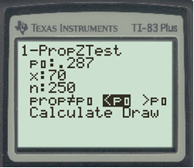
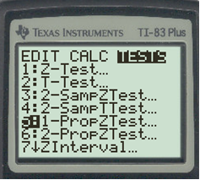
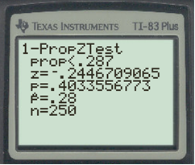
Test Statistic: The number that really matters is “z”, which is -.24467

Slide 112
Comparison: NOT SIGNIFICANT Since .24 is not greater than 2.326, we can’t say the player is performing significantly worse than normal.

Slide 113
Two Proportion z-test: • Does one group have a higher percentage with some characteristic than another group does?

Slide 114
You’re comparing two groups at the same time (rather than one group against what is expected).

Slide 115
Formula

Slide 116
On a TI-83, this is Test #6 (2-PropZTest).

Slide 117
Example: In 2000, Hillary Rodham-Clinton ran for the U.S. Senate from New York. A poll in the summer of 2000 found that among 350 women surveyed, 189 supported Mrs. Clinton’s campaign.

Slide 118
However, of 280 men surveyed, only 126 supported her. Is there a significant difference in Mrs. Clinton’s support between men and women? (Use the .10 level of significance.)

Slide 119
CRITICAL VALUE: • For .100, the critical value is z = 1.282 .

Slide 120
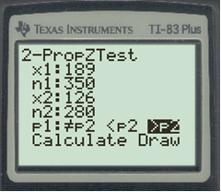
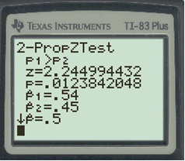
TEST STATISTIC What matters is z = 2.24

Slide 121
Interpretation: Since 2.24 > 1.282, this is a significant result. A significantly larger percentage of women than men support Hillary Rodham-Clinton for senator.

Slide 122
So how else can you do hypothesis tests?

Slide 123
Today many people use what is called p-value statistics. • The idea works backwards from the classical method.

Slide 124
• Use your data to calculate a p-value, which is the ACTUAL probability you say a result is significant, but it really just happened by chance.

Slide 125
• Compare your p-value to α, the level of significance. • If the p-value < α, then your result is significant.

Slide 126
For instance … • If the p-value is .034 and α = .05, then you have a significant result. • If the p-value = .034 and α = .01, then it’s NOT significant.

Slide 127
The advantage of p-value statistics is that you don’t need to look up a table value (cut-off) for comparison. The disadvantage is that you have to be very careful to correctly identify < or > on the input in your calculator.

Slide 128
EXAMPLE: Suppose you calculated a p-value of .0843 . If you are using the 10% level of significance, is this significant?

